Slide 1

Operating Systems
Virtual Memory
(Chapter 4.3)

Slide 2
Memory Management Outline
Processes (done)
Memory Management
  Basic (done)
  Paging (done)
  Virtual memory ←

Slide 3
Motivation
Logical address space larger than physical memory
  2³² about 4 GB in size
  “Virtual Memory”
  on special disk
Abstraction for programmer
Performance ok? Examples:
  Unused libraries
  Error handling not used
  Maximum arrays

Slide 4
Paging Implementation
Validation
Bit
Page 0
0
1
v
0
Page 1
1
0
i
1
Page 0
0
3
Page 2
2
3
v
2
1
Page 3
3
0
i
3
Page 2
2
Logical
Memory
Page Table
Physical
Memory
“What happens when access invalid page?”

Slide 5
Accessing Invalid Pages
Page not in memory
  interrupt OS => page fault
OS looks in table:
  invalid reference? => abort
  not in memory? => bring it in
Get empty frame (from list)
Write page from disk into frame
Reset tables (set valid bit = 1)
Restart instruction

Slide 6
Performance of Demand Paging
Page Fault Rate (p)
0 < p < 1.0 (no page faults to every ref is a fault)
Page Fault Overhead
  = write page in + update + restart
  Dominated by time to write page in
Effective Access Time
  = (1-p) (memory access) + p (page fault overhead)

Slide 7
Performance Example
Memory access time = 100 nanoseconds
Page fault overhead = 25 msec
Page fault rate = 1/1000
EAT = (1-p) * 100 + p * (25 msec)
  = (1-p) * 100 + p * 25,000,000
  = 100 + 24,999,900 * p
  = 100 + 24,999,900 * 1/1000 = 25 microseconds!
Want less than 10% degradation
  110 > 100 + 24,999,900 * p
  10 > 24,999,9000 * p
  p < .0000004 or 1 fault in 2,500,000 accesses!

Slide 8
No Free Frames
Page fault => What if no free frames?
  terminate process (out of memory)
  swap out process (reduces degree of multiprog)
  replace another page with needed page
  Page replacement
Page fault with page replacement:
  if free frame, use it
  else use algorithm to select victim frame
  write page to disk
  read in new page
  change page tables
  restart process

Slide 9
Page Replacement
0
1
v
1
2
v
(0)
0
i
(3)
Page 0
2
3
v
0
Page 1
(4)
3
0
i
(1)
1
Page 0
0
3
Page 2
Page Table
2
victim
1
Page 3
(2)
0
1
i
3
Page 2
v
(3)
2
Logical
Memory
1
0
i
Physical
Memory
Page Table

Slide 10
Page Replacement Algorithms
Every system has its own
Want lowest page fault rate
Evaluate by running it on a particular string of memory references (reference string) and computing number of page faults
Example: 1,2,3,4,1,2,5,1,2,3,4,5

Slide 11
First-In-First-Out (FIFO)
1,2,3,4,1,2,5,1,2,3,4,5
1
3 Frames / Process
2
3

Slide 12
First-In-First-Out (FIFO)
1,2,3,4,1,2,5,1,2,3,4,5
1
4
5
3 Frames / Process
9 Page Faults
2
1
3
3
2
4
How could we reduce the number of page faults?

Slide 13
Optimal
vs.
Replace the page that will not be used for the longest period of time
1,2,3,4,1,2,5,1,2,3,4,5
1
4 Frames / Process
2
3
4

Slide 14
Optimal
vs.
Replace the page that will not be used for the longest period of time
1,2,3,4,1,2,5,1,2,3,4,5
1
4
4 Frames / Process
2
6 Page Faults
3
4
5
How do we know this?
Use as benchmark

Slide 15
Least Recently Used
Replace the page that has not been used for the longest period of time
1,2,3,4,1,2,5,1,2,3,4,5
1
2
3
4

Slide 16
Least Recently Used
Replace the page that has not been used for the longest period of time
1,2,3,4,1,2,5,1,2,3,4,5
1
5
2
8 Page Faults
3
5
4
4
3

Slide 17
LRU Implementation
Counter implementation
  every page has a counter; every time page is referenced, copy clock to counter
  when a page needs to be changed, compare the counters to determine which to change
Stack implementation
  keep a stack of page numbers
  page referenced: move to top
  no search needed for replacement
(Can we do this in software?)

Slide 18
LRU Approximations
LRU good, but hardware support expensive
Some hardware support by reference bit
  with each page, initially = 0
  when page is referenced, set = 1
  replace the one which is 0 (no order)
Enhance by having 8 bits and shifting
  approximate LRU

Slide 19
Second-Chance
FIFO replacement, but …
  Get first in FIFO
  Look at reference bit
    bit == 0 then replace
    bit == 1 then set bit = 0, get next in FIFO
If page referenced enough, never replaced
Implement with circular queue

Slide 20
Second-Chance
(a)
(b)
1
1
0
1
0
2
0
2
Next
Vicitm
1
3
0
3
1
4
0
4
If all 1, degenerates to FIFO

Slide 21
Enhanced Second-Chance
2-bits, reference bit and modify bit
(0,0) neither recently used nor modified
  best page to replace
(0,1) not recently used but modified
  needs write-out (“dirty” page)
(1,0) recently used but “clean”
  probably used again soon
(1,1) recently used and modified
  used soon, needs write-out
Circular queue in each class -- (Macintosh)

Slide 22
Page Buffering
Pool of frames
  start new process immediately, before writing old
    write out when system idle
  list of modified pages
    write out when system idle
  pool of free frames, remember content
    page fault => check pool

Slide 23
Thrashing
If a process does not have “enough” pages, the page-fault rate is very high
  low CPU utilization
  OS thinks it needs increased multiprogramming
  adds another process to system
Thrashing is when a process is busy swapping pages in and out

Slide 24
Thrashing
CPU
utilization
degree of muliprogramming

Slide 25
Cause of Thrashing
Why does paging work?
  Locality model
    process migrates from one locality to another
    localities may overlap
Why does thrashing occur?
  sum of localities > total memory size
How do we fix thrashing?
  Working Set Model
  Page Fault Frequency

Slide 26
Working-Set Model
Working set window W = a fixed number of page references
  total number of pages references in time T
Total = sum of size of W’s
m = number of frames

Slide 27
Working Set Example
T = 5
1 2 3 2 3 1 2 4 3 4 7 4 3 3 4 1 1 2 2 2 1
W={1,2,3} W={3,4,7} W={1,2}
  if T too small, will not encompass locality
  if T too large, will encompass several localities
  if T => infinity, will encompass entire program
if Total > m => thrashing, so suspend a process
Modify LRU appx to include Working Set

Slide 28
Page Fault Frequency
increase
number of
frames
upper bound
Page Fault Rate
lower bound
decrease
number of
frames
Number of Frames
Establish “acceptable” page-fault rate
  If rate too low, process loses frame
  If rate too high, process gains frame

Slide 29
Outline
Demand Paging Intro (done)
Page Replacement Algorithms (done)
Thrashing (done)
Misc Paging
WinNT
Linux
“Application Performance Studies”

Slide 30
Prepaging
Pure demand paging has many page faults initially
  use working set
  does cost of prepaging unused frames outweigh cost of page-faulting?

Slide 31
Page Size
Old - Page size fixed, New -choose page size
How do we pick the right page size? Tradeoffs:
  Fragmentation
  Table size
  Minimize I/O
    transfer small (.1ms), latency + seek time large (10ms)
  Locality
    small finer resolution, but more faults
      ex: 200K process (1/2 used), 1 fault / 200k, 100K faults/1 byte
Historical trend towards larger page sizes
  CPU, mem faster proportionally than disks

Slide 32
Program Structure
consider:
  int A[1024][1024];
  for (j=0; j<1024; j++)
    for (i=0; i<1024; i++)
      A[i][j] = 0;
suppose:
  process has 1 frame
  1 row per page
  => 1024x1024 page faults!

Slide 33
Program Structure
  int A[1024][1024];
  for (i=0; i<1024; i++)
    for (j=0; j<1024; j++)
      A[i][j] = 0;
1024 page faults
Stack vs. Hash table
Compiler
  separate code from data
  keep routines that call each other together
LISP (pointers) vs. Pascal (no-pointers)

Slide 34
Priority Processes
Consider
  low priority process faults,
    bring page in
  low priority process in ready queue for awhile, waiting while high priority process runs
  high priority process faults
    low priority page clean, not used in a while
    => perfect!
Lock-bit (like for I/O) until used once

Slide 35
Real-Time Processes
Real-time
  bounds on delay
  hard-real time: systems crash, lives lost
    air-traffic control, factor automation
  soft-real time: application sucks
    audio, video
Paging adds unexpected delays
  don’t do it
  lock bits for real-time processes

Slide 36
Virtual Memory and WinNT/2000
Page Replacement Algorithm
  FIFO
  Missing page, plus adjacent pages
Working set
  default is 30
  take victim frame periodically
  if no fault, reduce set size by 1
Reserve pool
  hard page faults
  soft page faults

Slide 37
Virtual Memory and WinNT/2000
Shared pages
  level of indirection for easier updates
  same virtual entry
Page File
  stores only modified logical pages
  code and memory mapped files on disk already

Slide 38
Virtual Memory and Linux
Regions of virtual memory
  paging disk (normal)
  file (text segment, memory mapped file)
Re-Examine fork() and exec()
  exec() creates new page table
  fork() copies page table
    reference to common pages
    if written, then copied

Slide 39
Virtual Memory and Linux
Page Replacement Algorithm
  look in reserve pool for free frames
  reserves for block devices (disk cache)
  reserves for shared memory
  user-space blocks
  enhanced second chance (with more bits)
    “dirty” pages not taken first

Slide 40
Application Performance Studies and
Demand Paging in Windows NT
Mikhail Mikhailov
Ganga Kannan
Mark Claypool
David Finkel
WPI
Saqib Syed
Divya Prakash
Sujit Kumar
BMC Software, Inc.

Slide 41
Capacity Planning Then and Now
Capacity Planning in the good old days
  used to be just mainframes
  simple CPU-load based queuing theory
  Unix
Capacity Planning today
  distributed systems
  networks of workstations
  Windows NT
  MS Exchange, Lotus Notes

Slide 42
Experiment Design
Does NT have more hard page faults or soft page faults?
System
  Pentium 133 MHz
  NT Server 4.0
  64 MB RAM
  IDE NTFS
  NT v 4.0
clearmem
Experiments
  Page Faults
  Caching
Analysis
  perfmon

Slide 43
Page Fault Method
“Work hard”
Run lots of applications, open and close
All local access, not over network

Slide 44
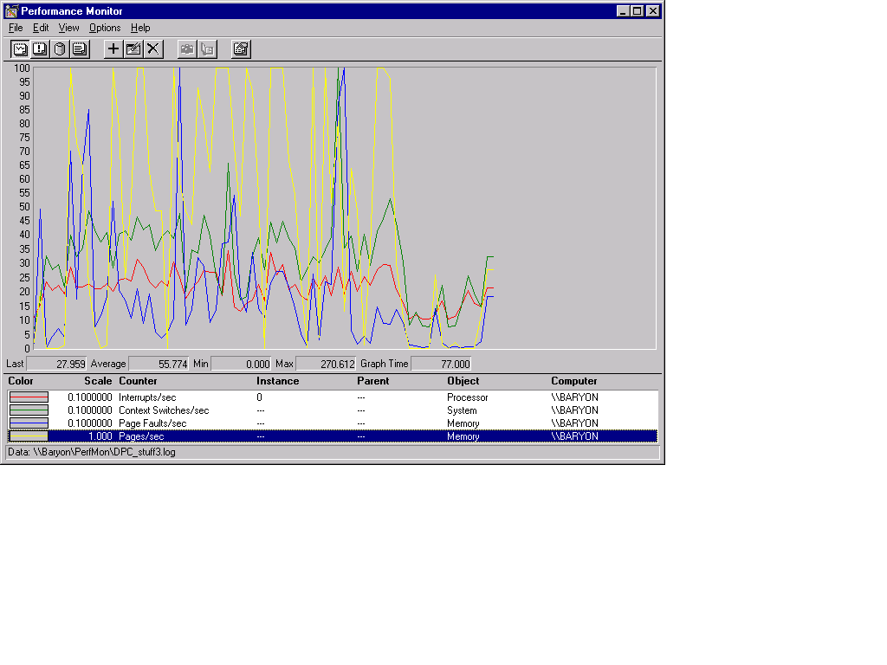
Soft or Hard Page Faults?

Slide 45
Caching and Prefetching
Start process
  wait for “Enter”
Start perfmon
Hit “Enter”
Read 1 4-K page
Exit
Repeat

Slide 46
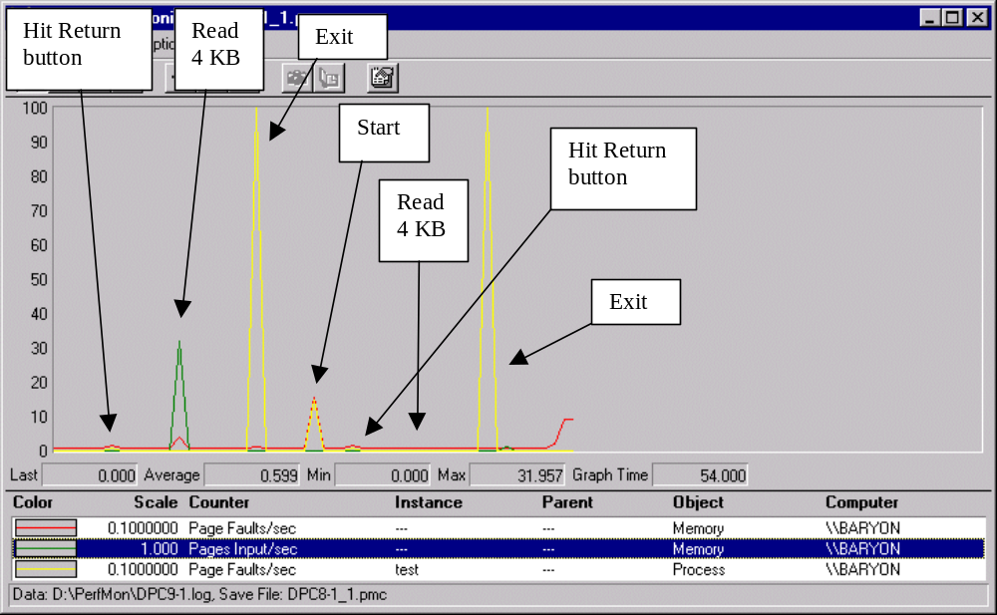
Page Metrics with Caching On

